Slide 1
ColorPaletteSearchColor
VIAN search color: lavender
Threshold: 0-1%

Slide 2
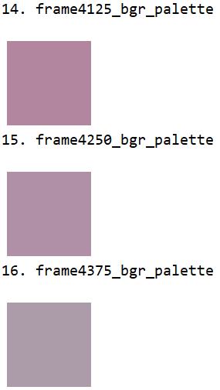
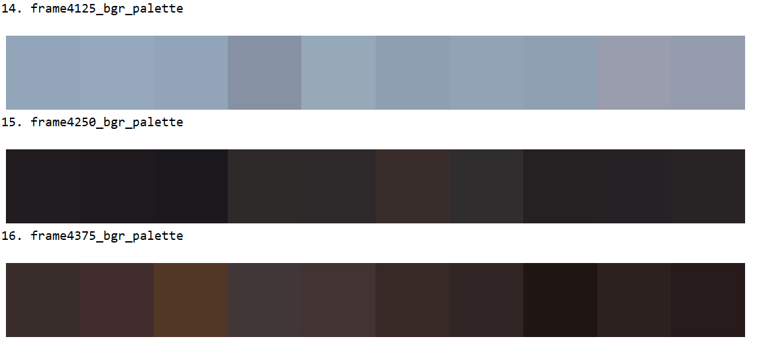
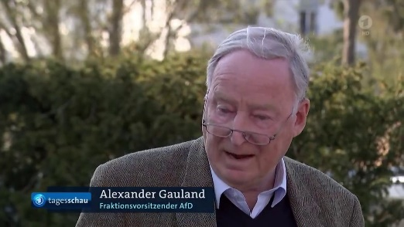
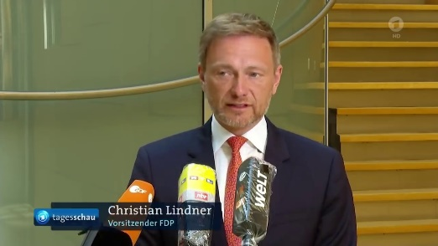
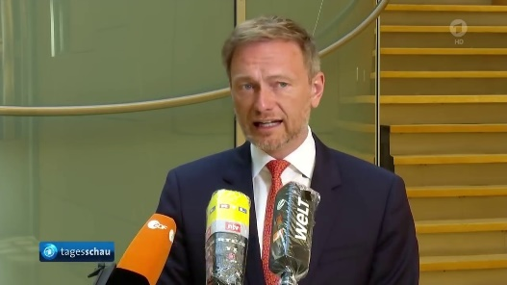
Gold color Color palette Video image

Slide 3
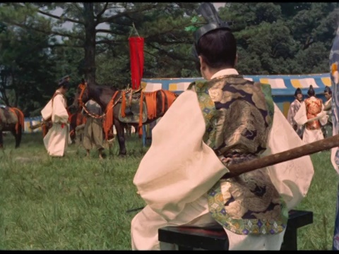
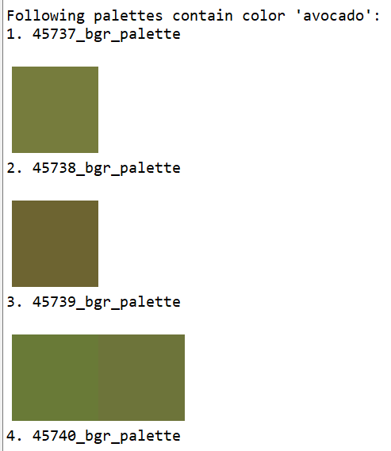
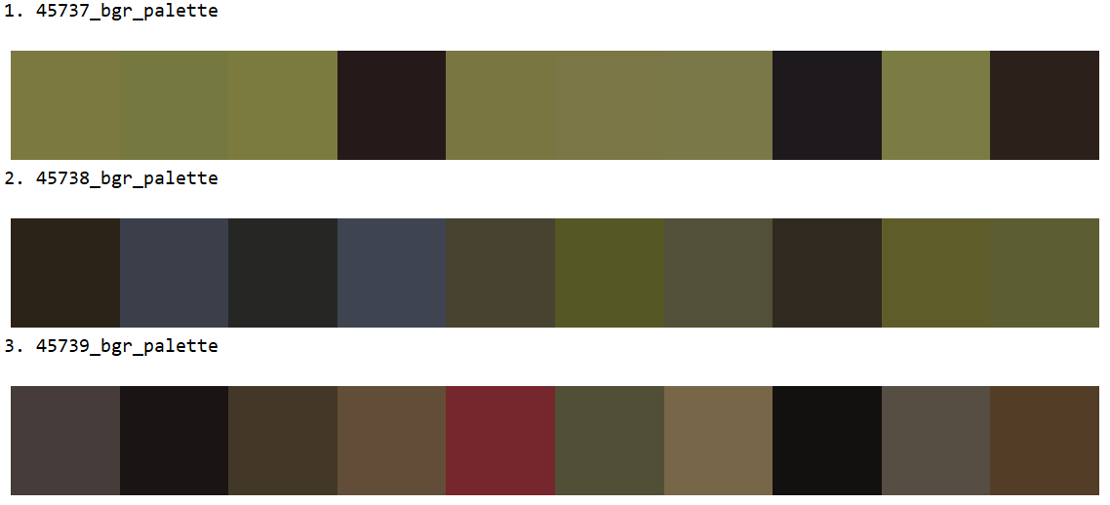
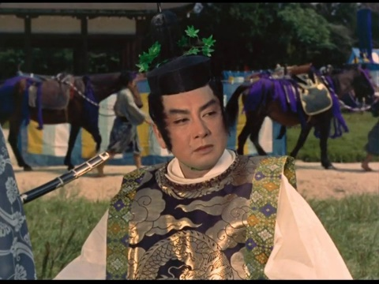
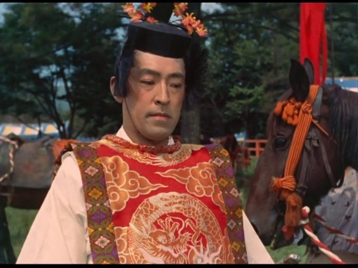
Avocado, threshold = 1
Gold color Color palette Video image

Slide 4




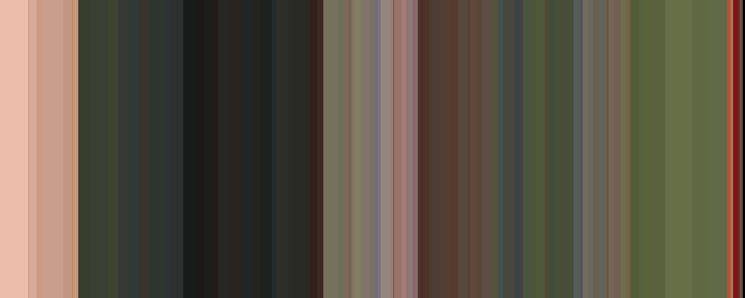
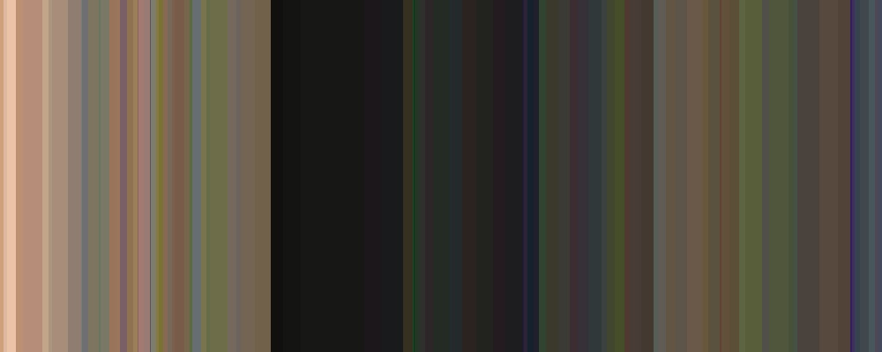
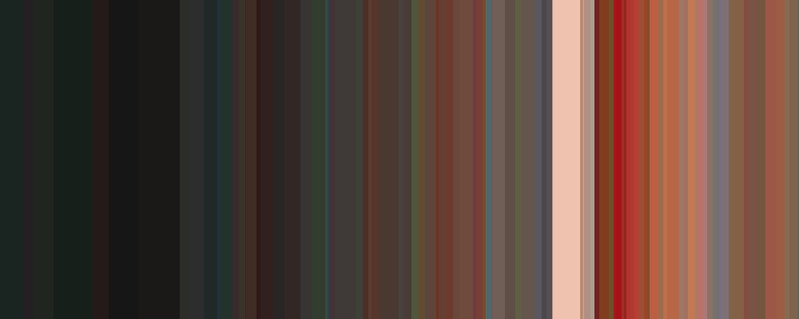
Avocado, threshold = 0
Search Query
VIAN dictionary color: avocado
Palette depth: 20
Threshold: 0
Color patches: 10
Movie: Jigokumon
Color Name Dictionary: EFFCND Thesaurus-Interval
Machine Learning Classifier: Gaussian Naïve Bayes
Number of Color Palettes: 569
45737.jpg
45738.jpg
45739.jpg
avocado
1.
2.
3.

Slide 5

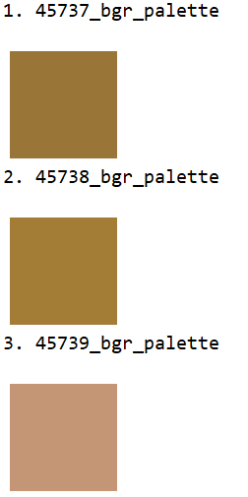
VIAN: Mustard, threshold = 1
Search Query
VIAN basic color: mustard
Palette depth: 20
Threshold: 1
Color patches: 10
Movie: Jigokumon
Color Name Dictionary: EFFCND Thesaurus-VIAN
Machine Learning Classifier: Gaussian Naïve Bayes
Number of Color Palettes: 569
45737.jpg
45738.jpg
45739.jpg
mustard
1.
2.
3.

Slide 6
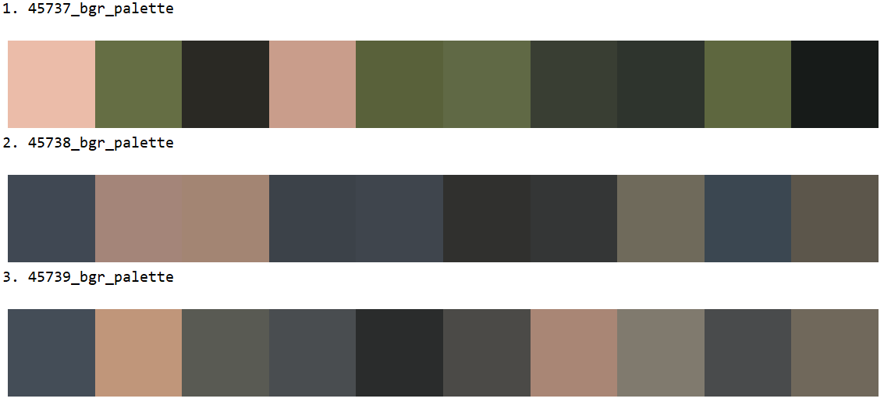
VIAN: Mustard, threshold = 0
Gold color Color palette Video image

Slide 7
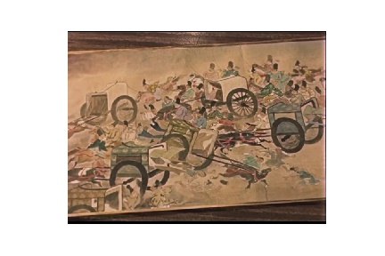
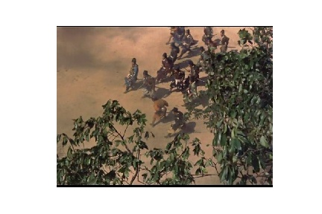
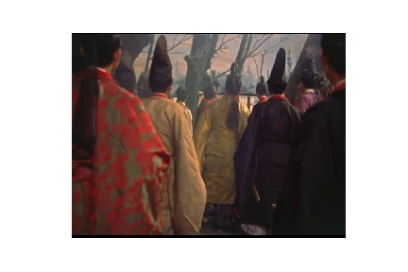
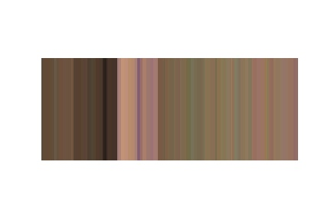
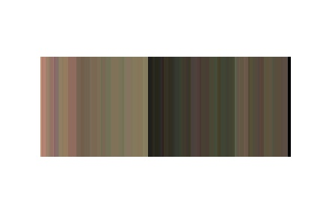
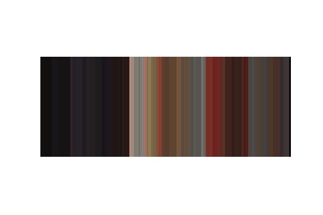
(a)
(b)
(c)
45442.jpg
45479.jpg
45472.jpg

Slide 8
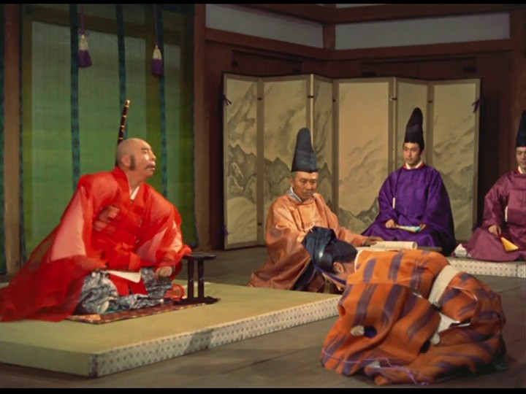
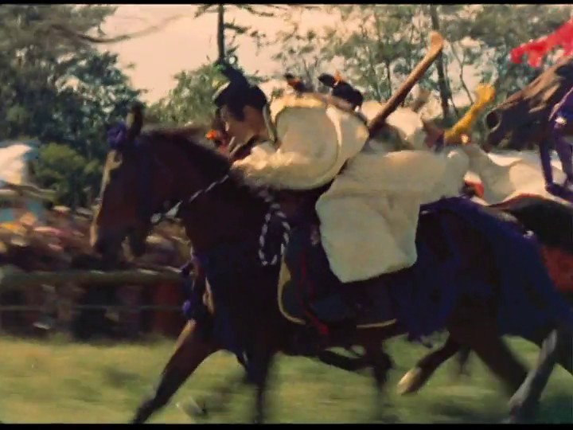
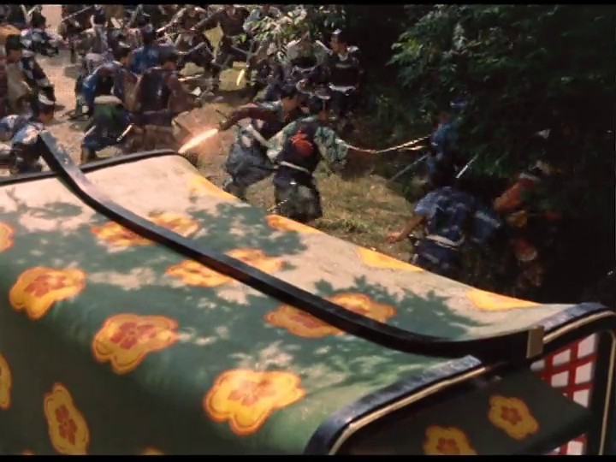
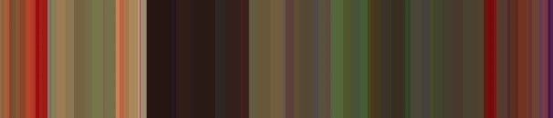
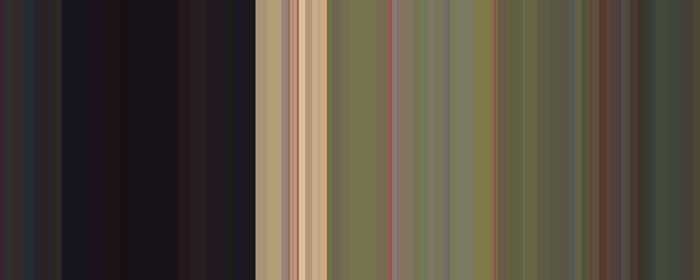

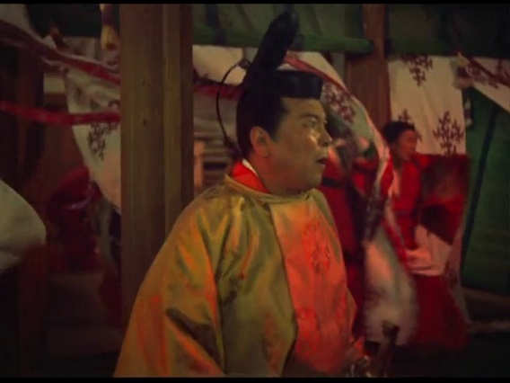
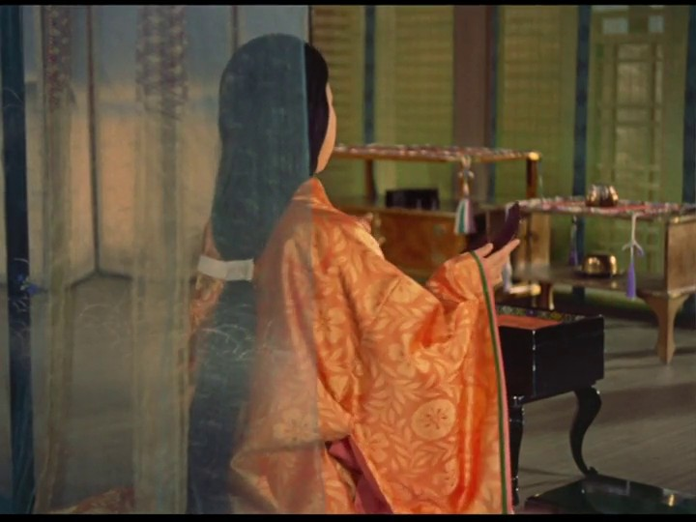
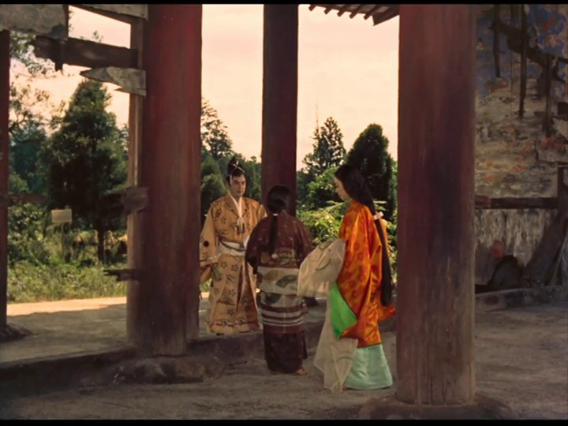
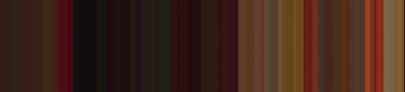
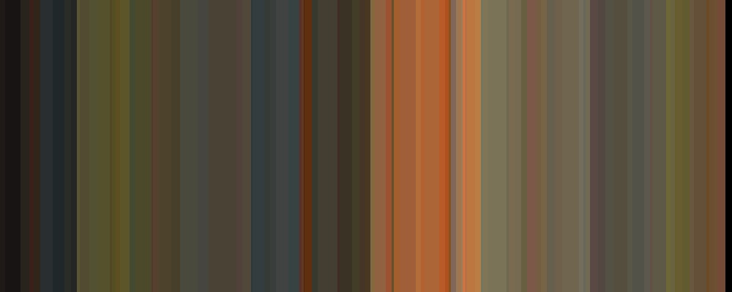
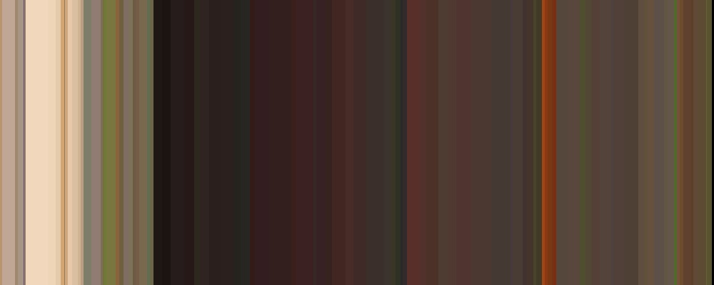
(a) Contrast of hue
(b) Light-dark contrast
(c) Cold-warm contrast
Frame: 45643
Frame: 45766
Frame: 45490
(d) Complementary contrast
(e) Contrast of saturation
(f) Contrast of extension
Frame: 45455
Frame: 45806
Frame: 45636

Slide 9
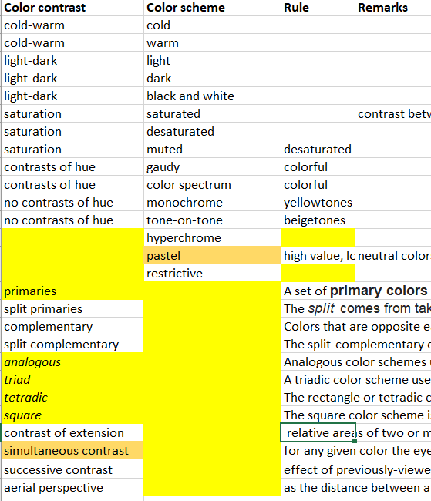
DONE
WHY not
Yellow too?
impossible

Slide 10
Harmony - No Contrast of Extension
Violet:yellow – Proportion: 3:1
Disharmony - Contrast of Extension
Violet:yellow – Proportion: 1:3

Slide 11
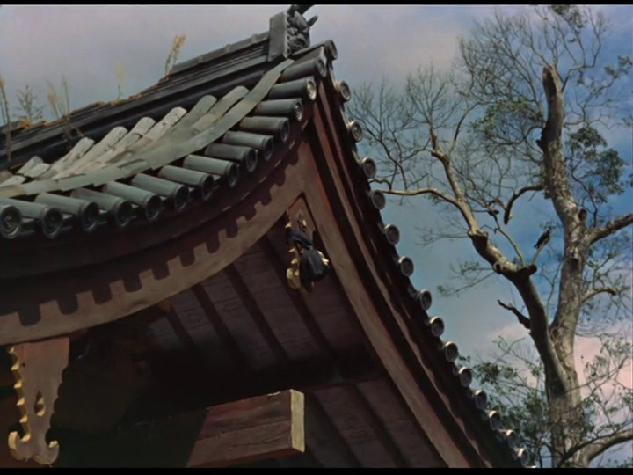
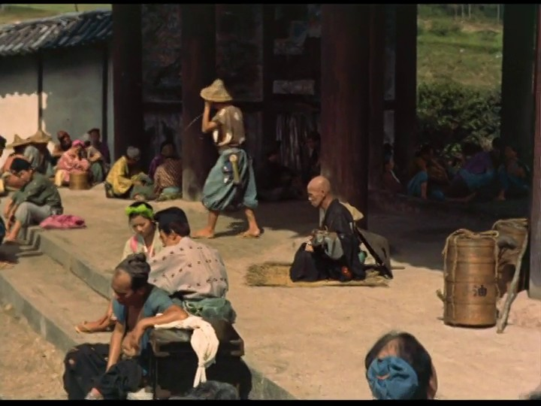
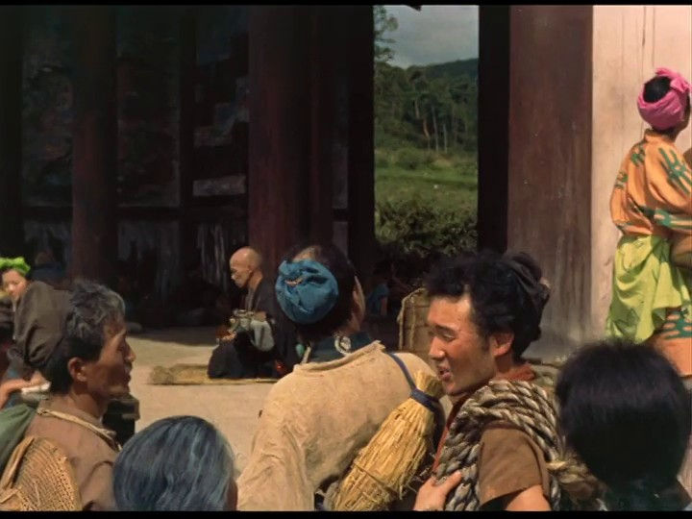
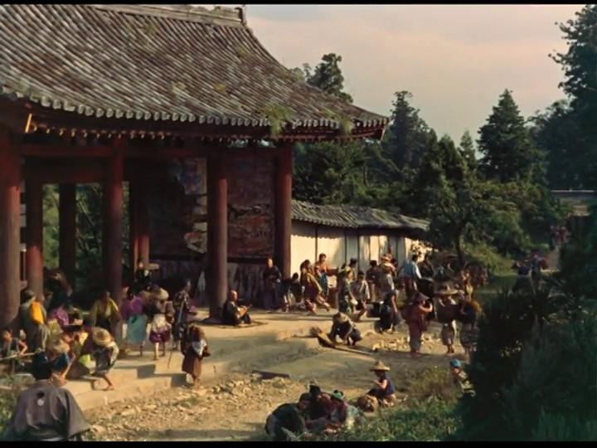
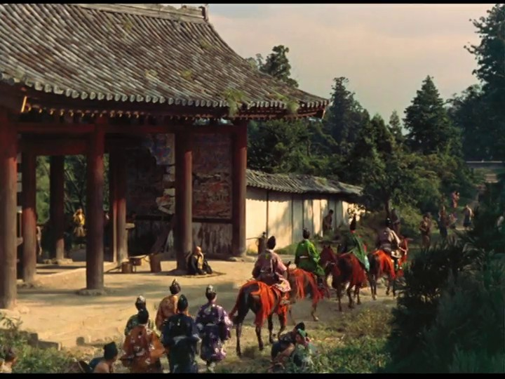
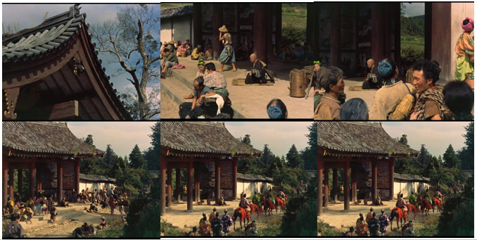

Slide 12
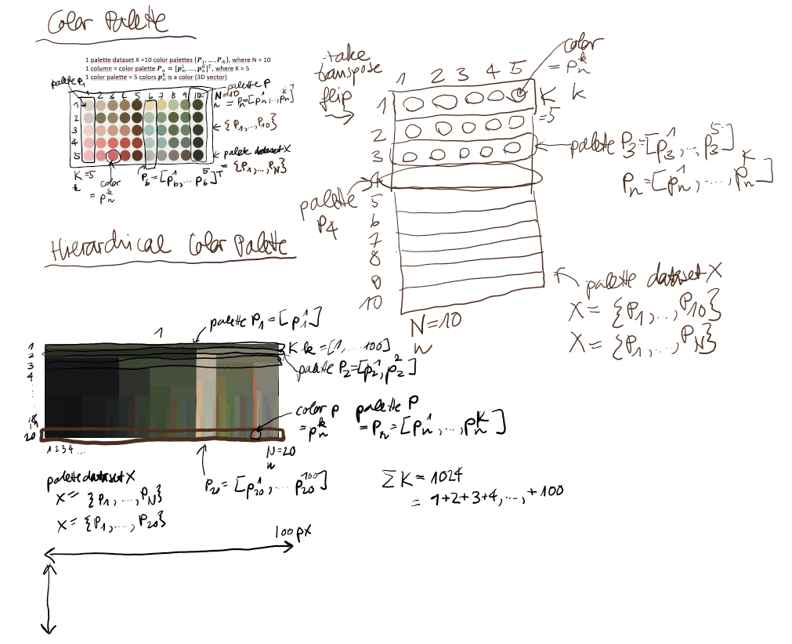

Slide 13
Workflow
There are 720 possible dict colors,
but 255**3 = 16’581’375 possible patch colors.
Dictionary: <dict color> {text, number, image} subspace
Machine learning training: <dict color; color category> subspace-to-space generalization
Color category: dict color {text, number, image}
Color category: basic color {text, number, image}
Color category: contrast color {text, number, image}
Image aka Color Palette: <patch color> {text, number, image} space
Machine learning prediction on Color Palette: <patch color; color category>
Color category: dict color {text, number, image}
Color category: basic color {text, number, image}
Color category: contrast color {text, number, image}
Pairs’ Distance Calculation of Images aka Color Palettes aka Color Histograms: <patch color; patch color> {text, number, image} space
Artistic-to-Scientific Rules Transformation and Application of Color Contrast Rules on Color Palette: <contrast color; color contrast>
Color contrast {text}
Queries
1. «Exact» Search query: <color category>** {text, number, image} → Search result: top-ratio Image aka Color Palette <patch color>
2. «Similar» Search query: <image aka color palette img aka color histogram> {image} → Search result: top-n <image aka color palette img aka color histogram>
3. «Classified» Search query: <color contrast>** {text} → Search result: Image aka Color Palette <patch color>

Slide 14
Queries
Queries
1. «Exact» search query: <color category>** {text, number, image} → Search result: top-ratio plate <patch color>
Color category: space color {number (=HEX, RGB, HSV, CMYK, LAB), image (=icon, patch, picker)}**
Color category: dictionary color {text (=color name), number (=HEX, [RGB, HSV, CMYK, LAB]), image (=icon, patch, picker)}**
Color category: basic color {text (=color name), number (=HEX, [RGB, HSV, CMYK, LAB]), image (=icon, patch, picker)}**
Plate: movie frame {image (=JPG, PNG)}
Plate: color palette {image (=JPG, PNG)}
2. «Similar» search query: <plate> {image} → Search result: top-n plate <plate>
Plate: movie frame {image (=JPG, PNG)}
Plate: color palette {image (=JPG, PNG)}
Plate: histogram {image (=JPG, PNG)}
3. «Classified» search query: <color contrast>** {text} → Search result: top-id plate <patch color>
Color contrast {text (=contrast name)}**
Plate: movie frame {image (=JPG, PNG)}
Plate: color palette {image (=JPG, PNG)}

Slide 15
Classification
Color classification
Color palette classification
Patch color
color category
Patch color
color category
Color contrast
Dict color: aliceblue
Basic color: blue
Dict color: aliceblue
contrast color: blue
Dict color: aliceblue
Dict color: aliceblue
Dict color: grass
contrast color: green
contrast of hue
Non-dict color: aliceblue2
Dict color: aliceblue
Non-Dict color: vermillion2
contrast color: red
Color Palette X’’
Color Palette X
Color Palette X’
Color Palette X
Color Palette X’
Search basic color «blue» or dict color «alice blue»
Search color contrast «contrast of hue»

Slide 16
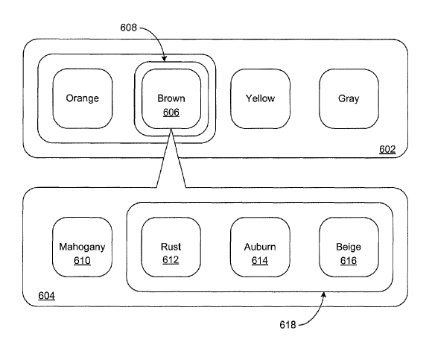
Color scheme
basic color
Color palette
dict color
Image
Non-dict color

Slide 17
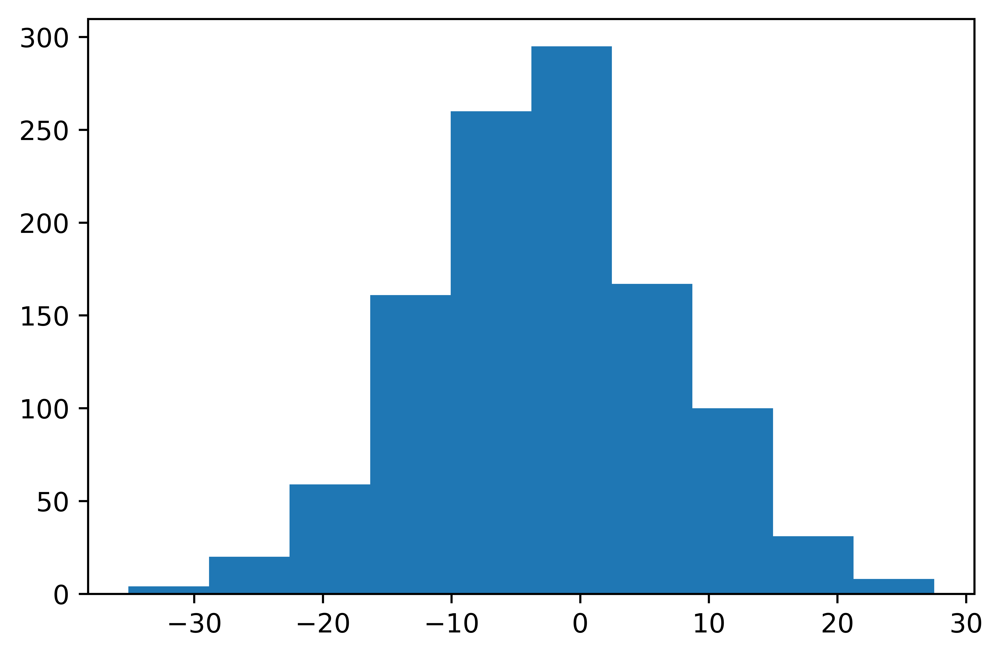
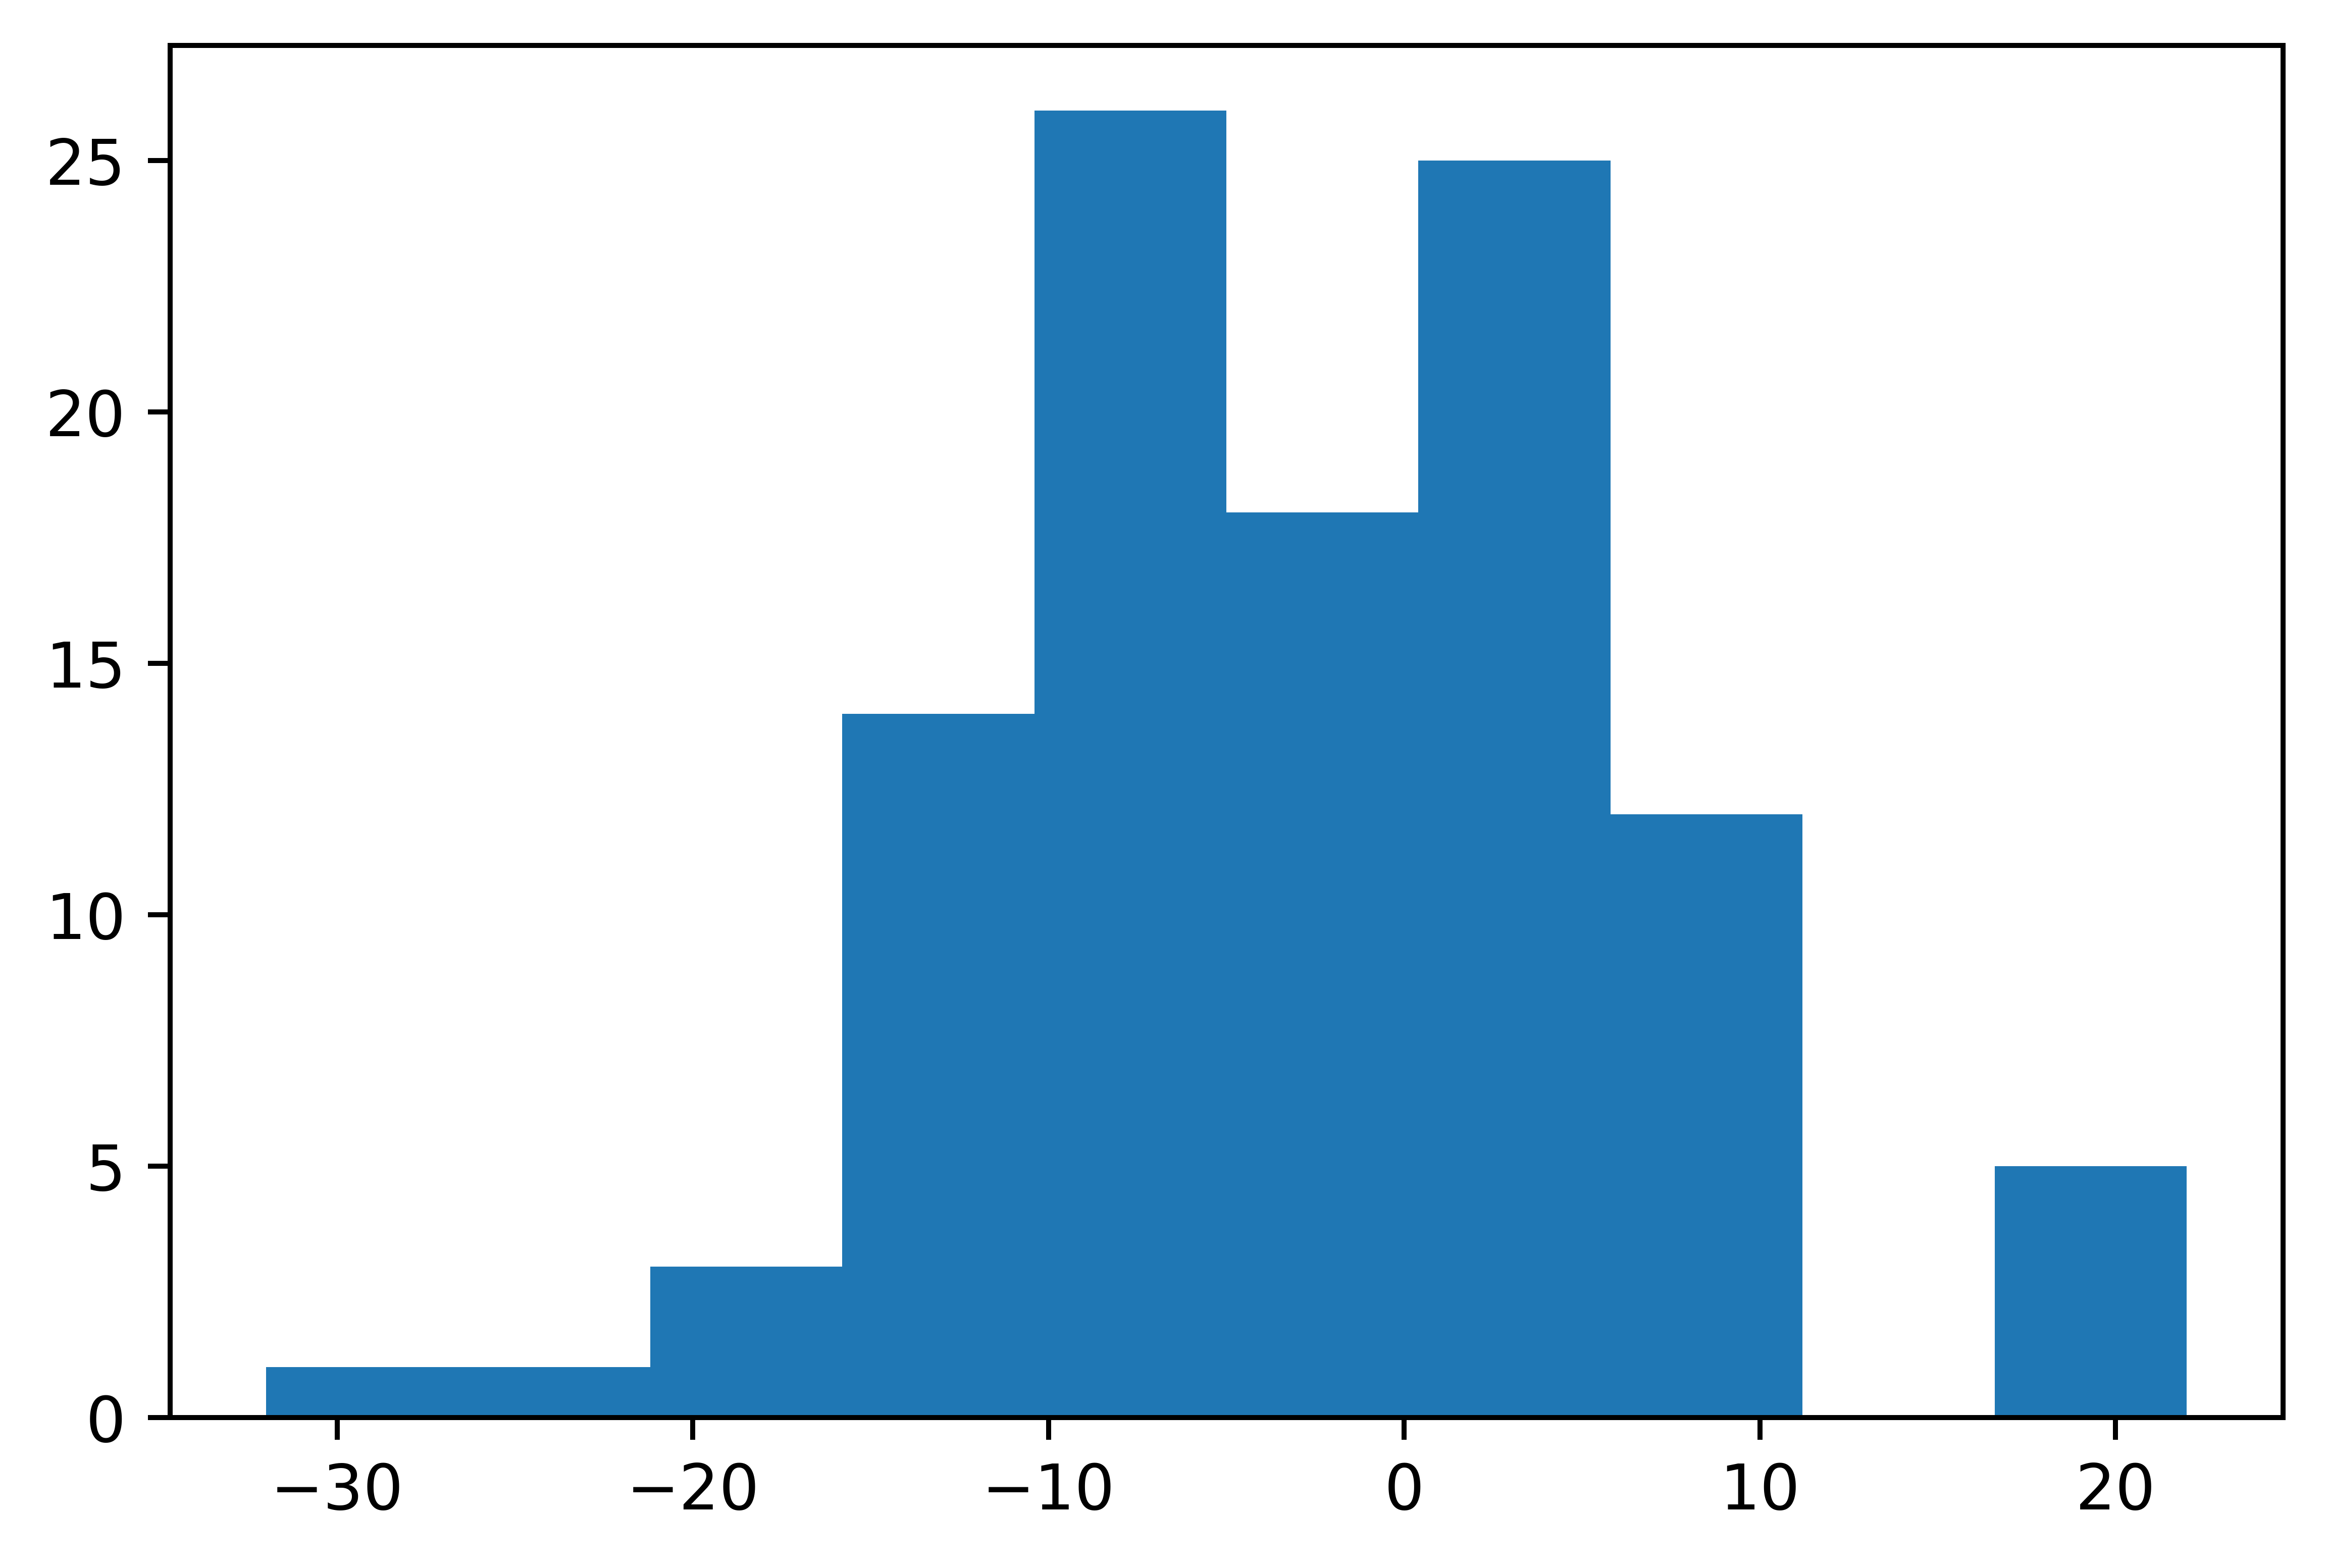
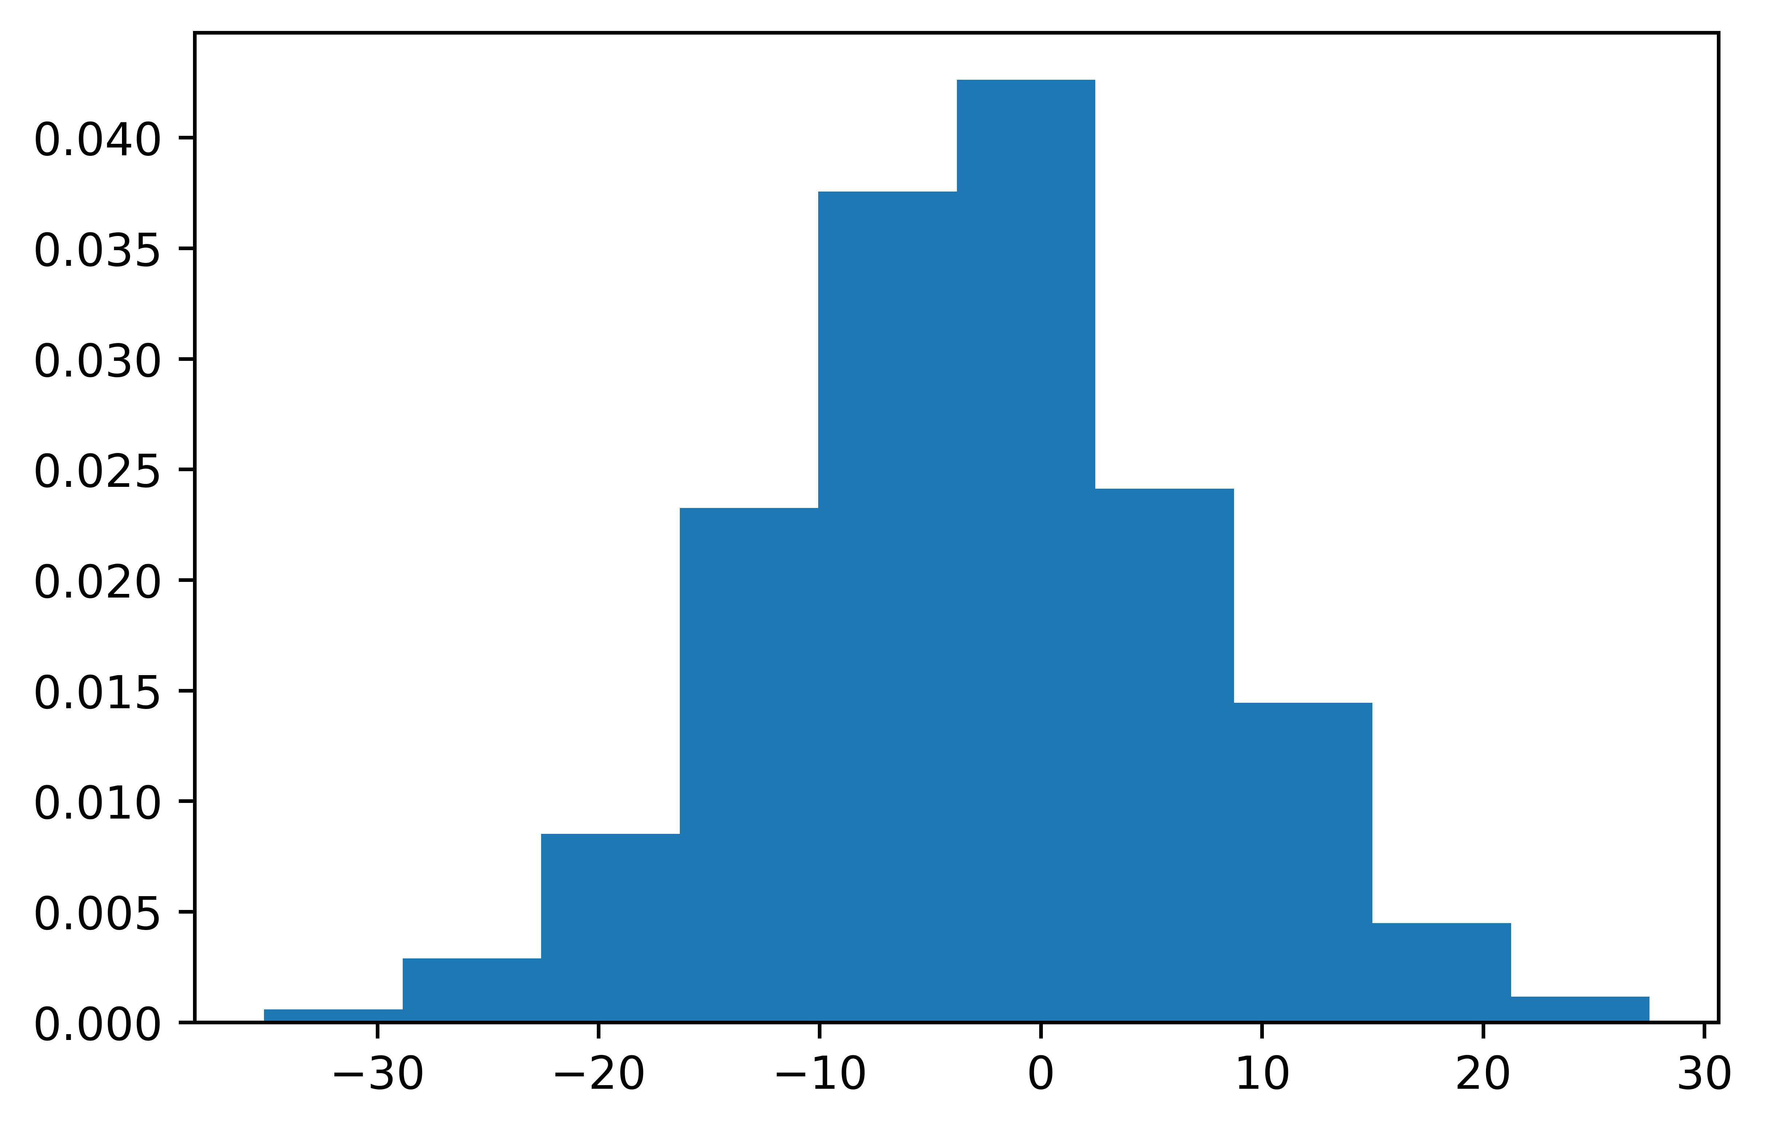





















































































































































































































































A-channel (cielab) for color category = ‘blue’
(a)
frequency
a-channel (L*ab)
(b)
frequency
probability
a-channel (L*ab)
a-channel (L*ab)
Mean:
Standard deviation:

Slide 18

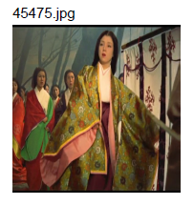
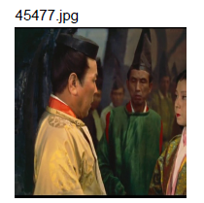
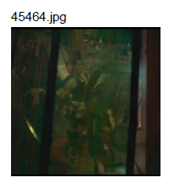
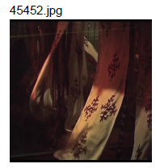
Complementary contrast: red-green?

Slide 19
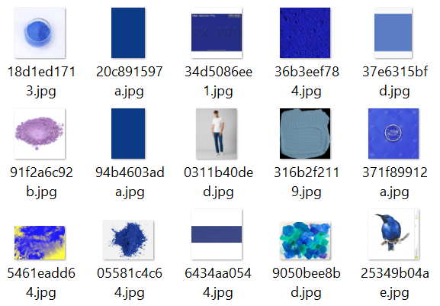

(a)
(b)
ultramarine
RGB(63,61,143)

Slide 20
